Slide 1

CAPSTONE PROJECT - predictive model for HEART DISEASE
Catherine Nguyen

Slide 2



Slide 3

AGENDA
A. Problem Statement
B. Dataset Description
C. Process
D. Recommendations

Slide 4

A. PROBLEM STATEMENT

Slide 5

A. Problem Statement
BACKGROUND:
Heart disease is a leading cause of mortality worldwide.
Early detection and accurate prediction of heart disease can significantly improve patient outcomes by enabling timely intervention and preventive measures.
OBJECTIVE: To enhance and evaluate a predictive model → effectively predict the presence or absence of heart disease based on various medical and lifestyle factors.
HYPOTHESIS: To find relationship between attributes (if any) with the heart disease
HOW: By analyzing a comprehensive set of patient attributes:
demographic, clinical, and lifestyle factors
AIMS: The model is able
identify patterns and features
indicative of the presence or absence of heart disease

Slide 6

B. DATASET DISCRIPTION

Slide 7
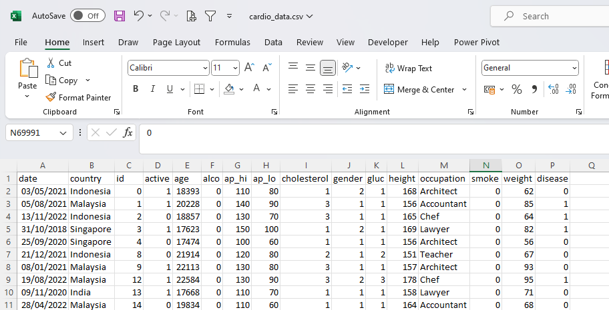
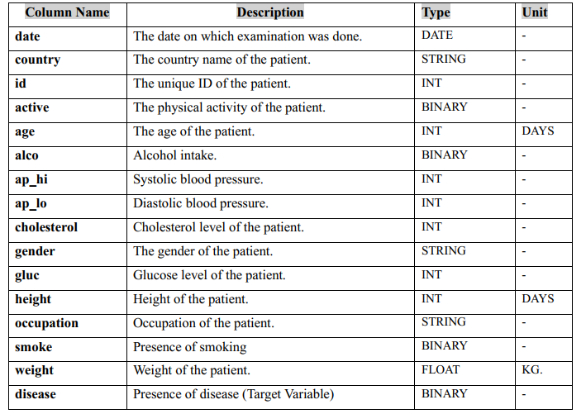
B. Dataset Description
Dataset worked on for a project of Parkway Pantai
Notes:
Csv file
Dictionary data

Slide 8

C. PROCESS

Slide 9
C. Process
1. Data Cleaning
Power Query:
2. Exploratory Data
Power BI : Visualize data
3. Feature Selection & Training Model
Python Machine Learning: 3 models
+ Remove irrelevant data
5. Evaluate Model
+ Checked duplicated
+ Checked missing
Logistic Regression
Kneighbour
Random Forest
Python
Accuracy Level
6. Test Model
Python
Baseline
Baseline remove ap-lo
Confusion Matrix
Baseline add BMI
Classification Report
4.Choosing Predictive Models
Python : Statistic Analysis and heatmap correlation; Visual analysis
Baseline remove height
Baseline add BMI remove height
Baseline add BMI, remove ap_lo, remove ap_hi
Baseline add BMI, Blood Pressure Level

Slide 10

1. Data Cleaning

Slide 11
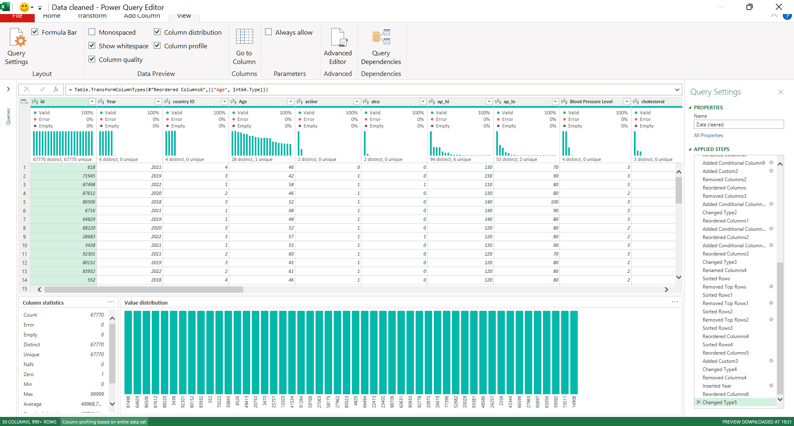
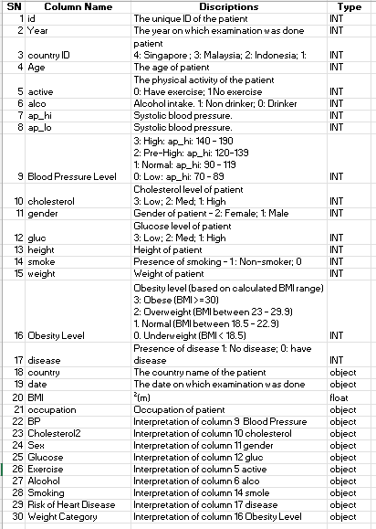
1. Data Cleaning
Used Power Query to perform data cleaning: check missing, blank, error, duplicate, correct data type, age column ( convert days into Year), corrected ap_hi with negative figure (assumption: typo) , etc.
Before cleaning
After cleaning
70,000 rows; 16 columns
0 missing values
67770 rows; 30 columns
0 missing values
We also removed:
+ ap_hi above 190, below 70
+ ap_lo above 100 and below 40
+ height below 140cm..
+ weight below 38kg.
+ height 250cm
Notes:
Our assumption for ap_hi is 70-190 and ap_lo is 40-100 , based on blood pressure chart research from blood pressure UK
Similarly for weight and height, our assumption is height is 1.4m to 2.5m and weight is above 38kg
We also used column profile, column quality and column distribution to check and ensure no empty, no error, unique, distinct value for each column

Slide 12

2.Exploratory Data Analysis
Notes:
Under exploratory data analysis, we use power Bi and Python to sanity analyze data

Slide 13

Power BI : Visualize data
Notes:
We used power BI as first glance understand and visualize data

Slide 14
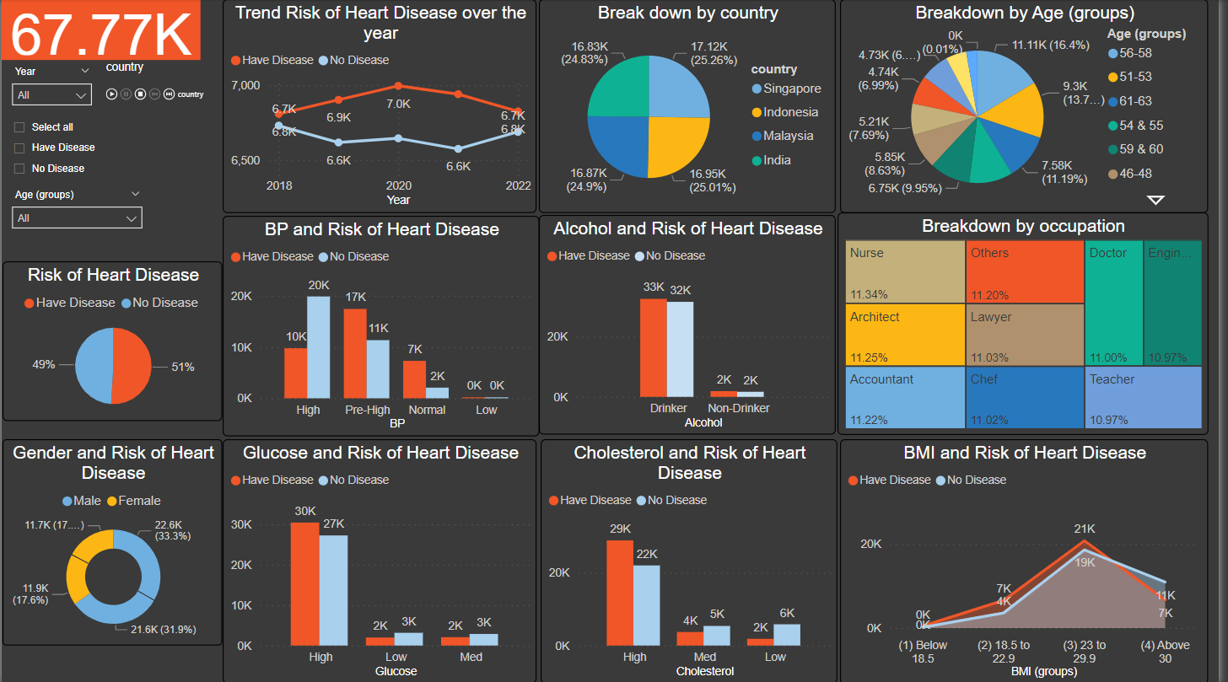
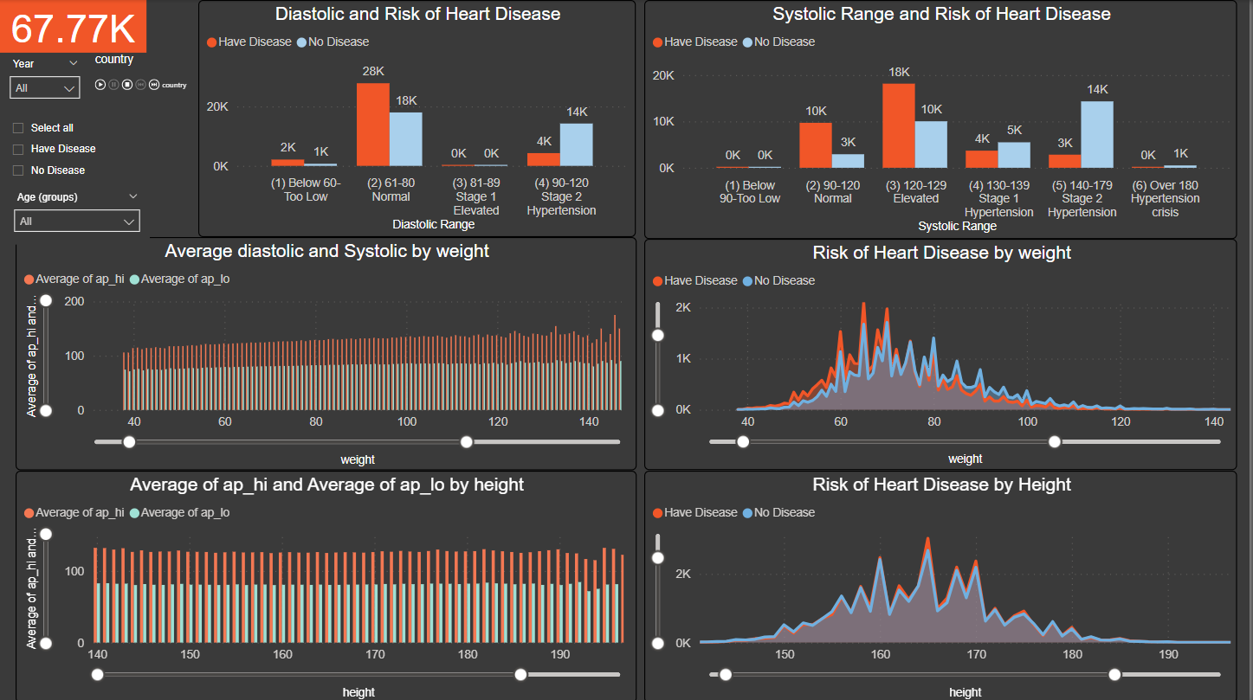
Overall Summary
Analyze Diastolic, Systolic with Weight, Height and Risk of disease
From high level , we analyse the relationship each factor with disease and understand the population breakdown
Next, we analyse relationship among few factors to understand whether there is any relationship, pattern or trend
Notes:
We performed overall summary

Slide 15
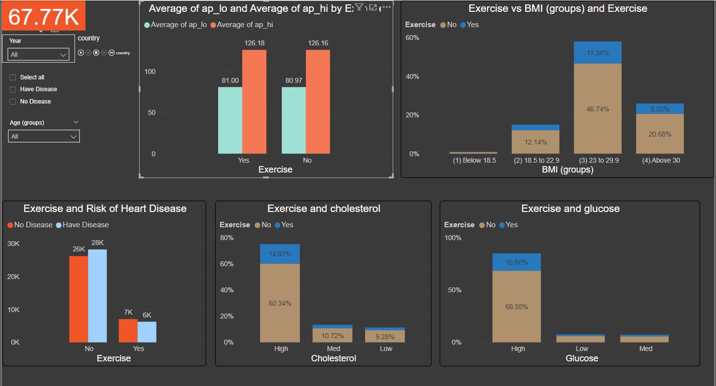
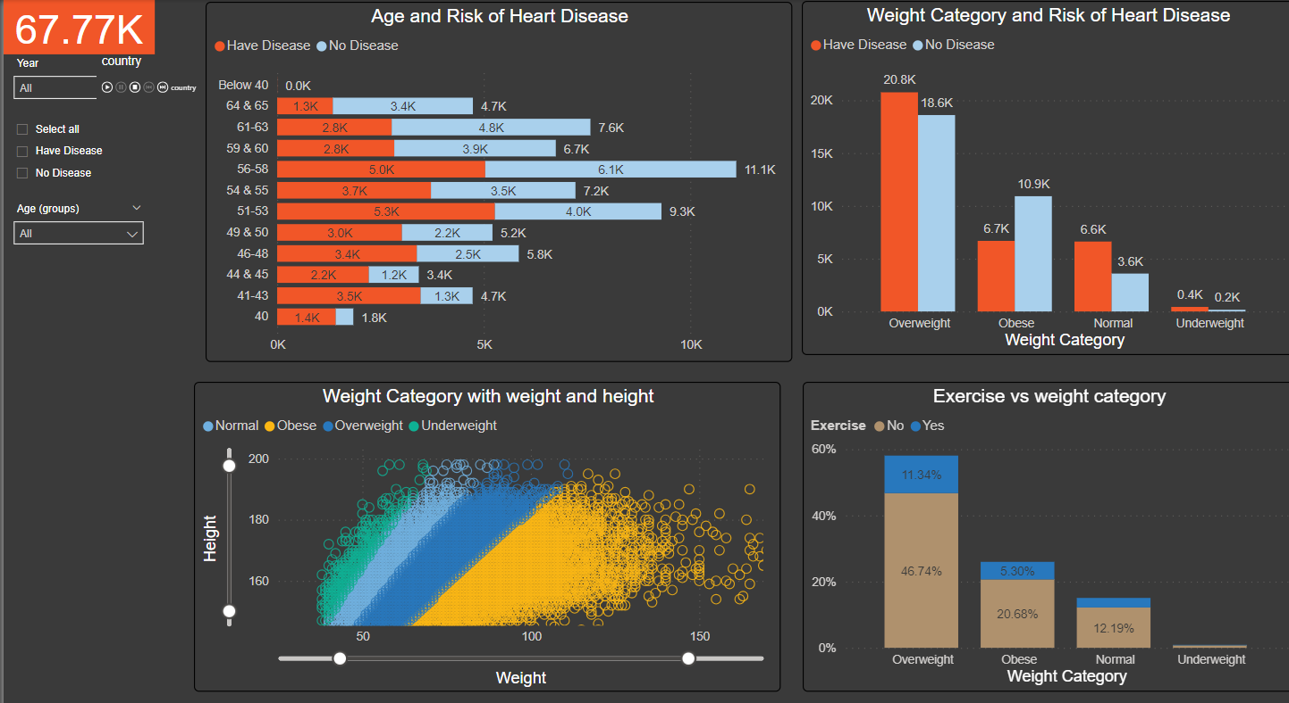
Analyze Exercise with Blood pressure, BMI, cholesterol Glucose and Risk of disease
Analyze Age, Weight Category and Risk of disease
Continue analyse the relationship among few factors to understand whether there is any relationship, pattern or trend
Continue analyse the relationship among few factors to understand whether there is any relationship, pattern or trend

Slide 16

After Power BI
Relationship each single attributes to disease → NO
Any patterns the presence or absence of heart disease → NO
The information derived from the dataset indicates a widespread distribution → NO clear connections
Next Thought : to find relationship with disease by analyzing collective combination of attributes
Next Question : there are numerous possibilities, and
Unknown how the disease coding (0,1) is derived
Unascertained the interpretation of each factor coding (0,1)
How the significance of each factor is weighted.
→ We use Python to perform Statistic Analysis and heatmap correlation, other visual analysis from different libraries in Python

Slide 17

Python
Descriptive Statistic Analysis
Correlation analysis
Visual analysis

Slide 18
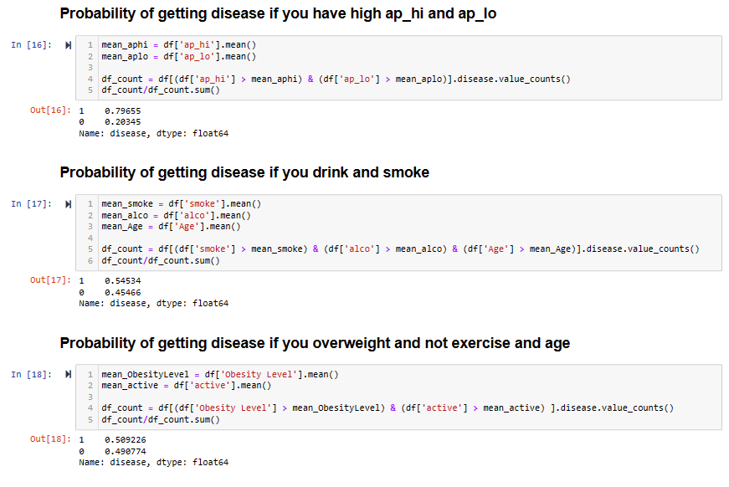
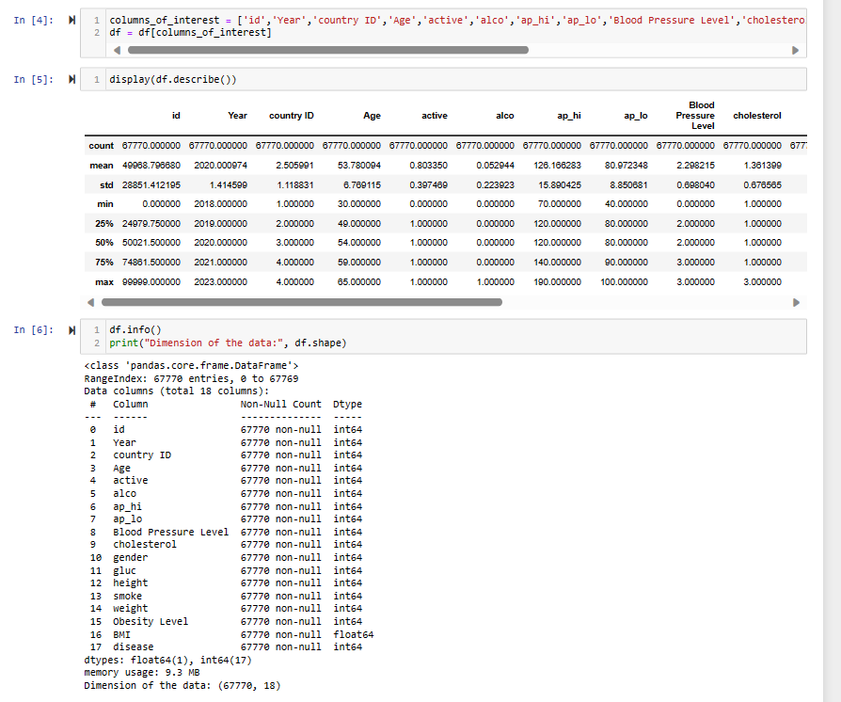
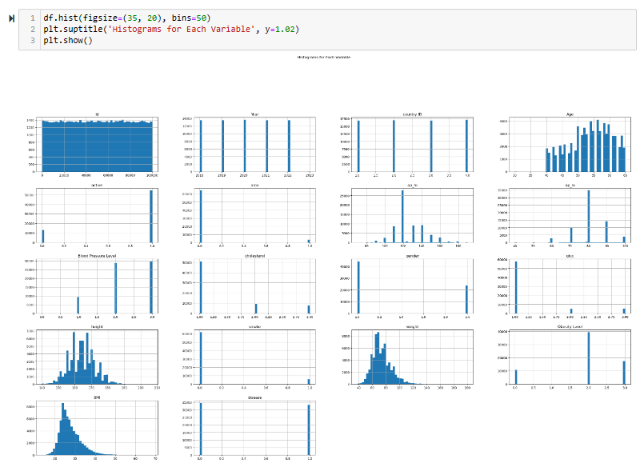
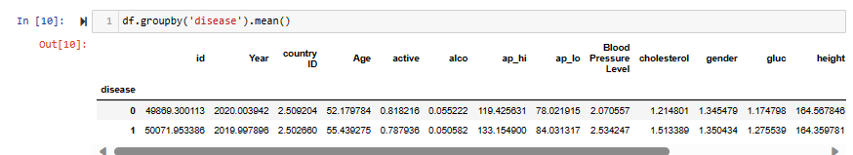
Descriptive Statistics Analysis
Notes:
We use data frame describe to get statistic analysis, data frames shape to recheck data type for each column and any null data
We find mean mean each factor with disease
We check probability of getting disease with few of each factor e.g. ap_hi, ap_lo, smoke, drink, exercise, weight , age
We plotted histogram chart to understand distribution each factor

Slide 19
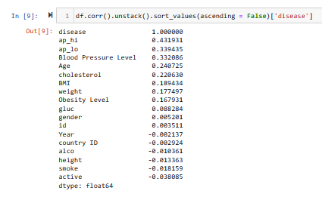
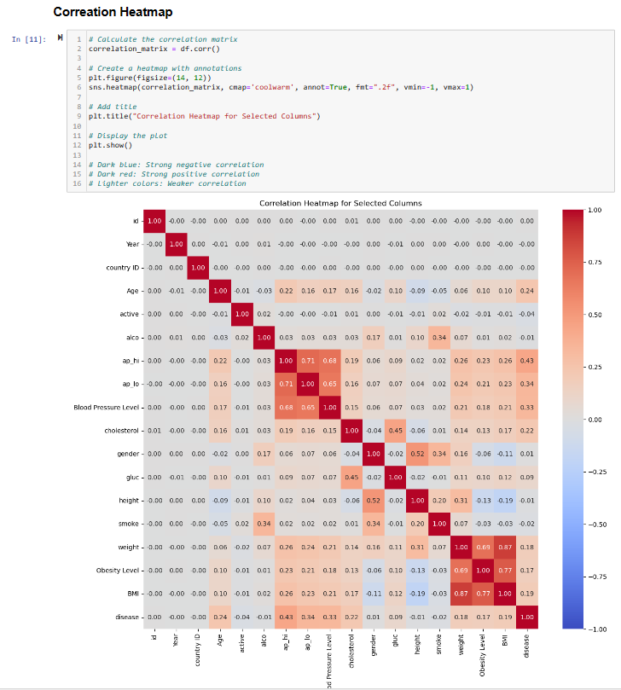
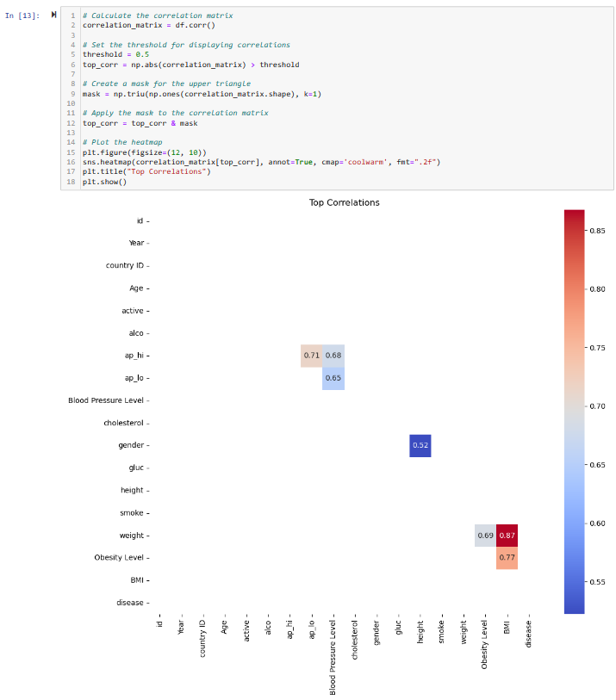
Correlation Analysis
Notes:
Next we lot correlation heatmap
Find and sort correlation between disease with each factor to find which one has strongest correlation

Slide 20
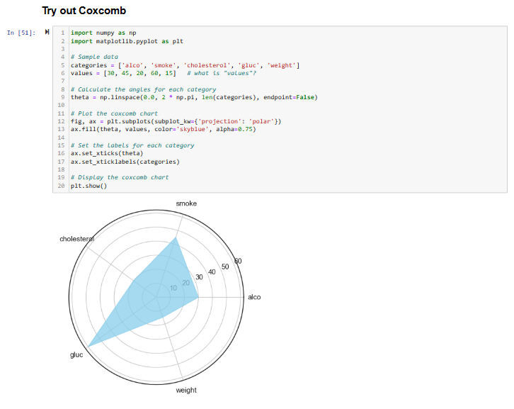
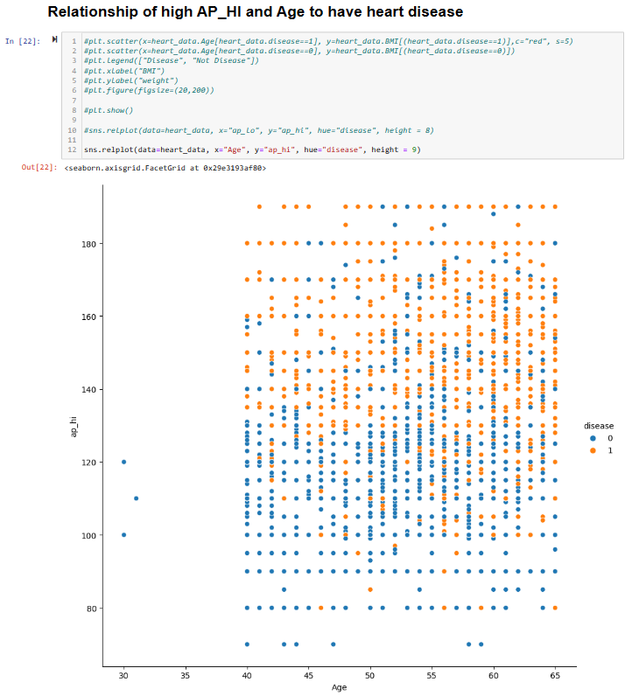
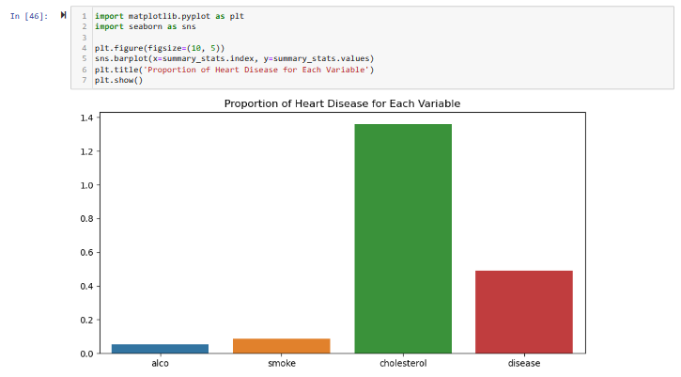
Visual analysis

Slide 21
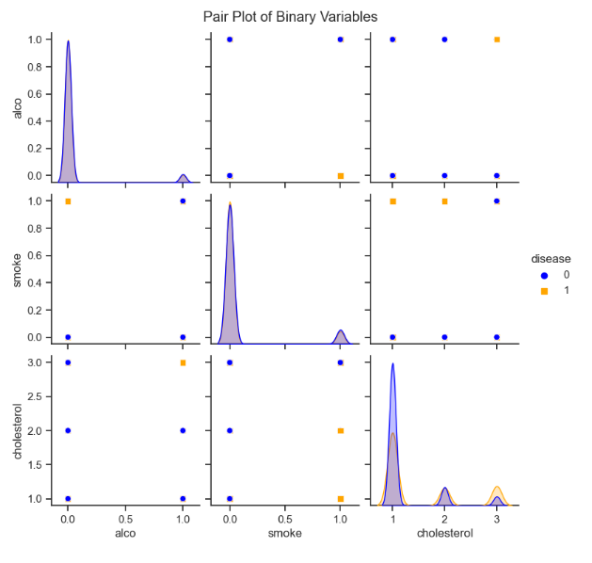
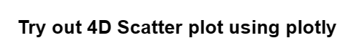
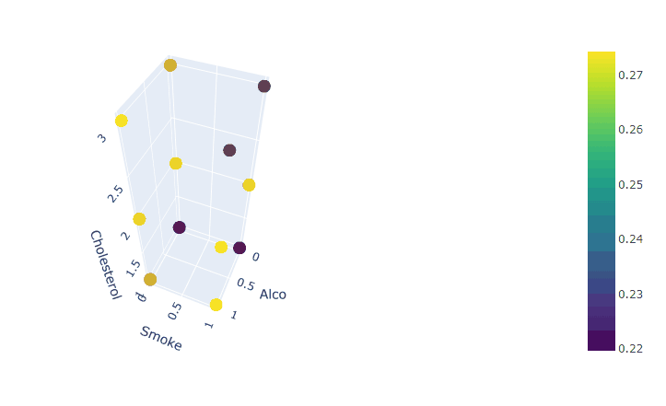
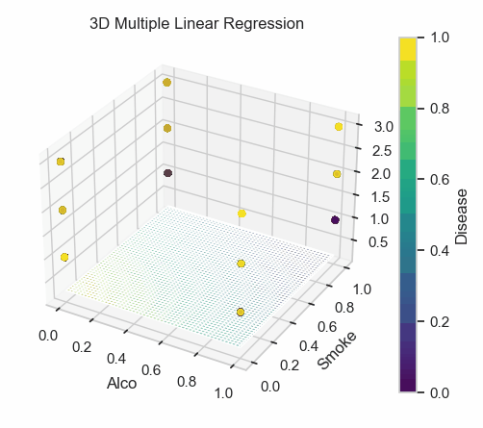
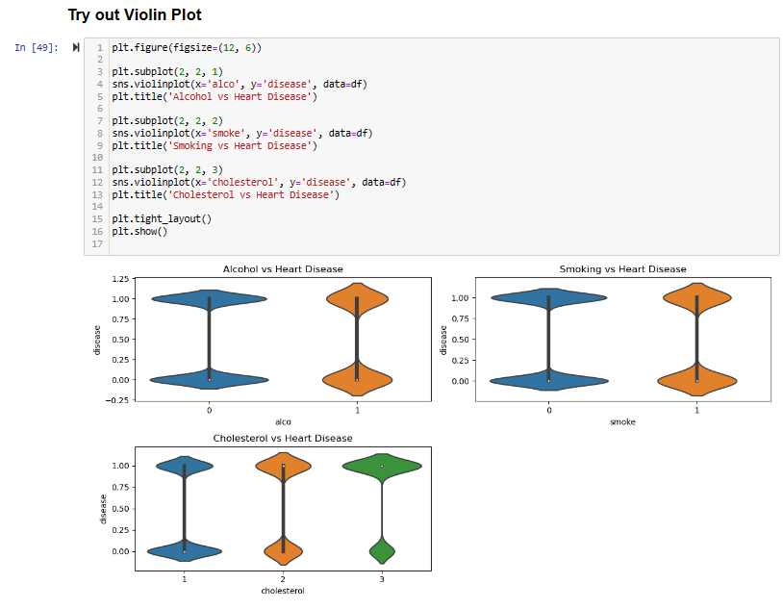
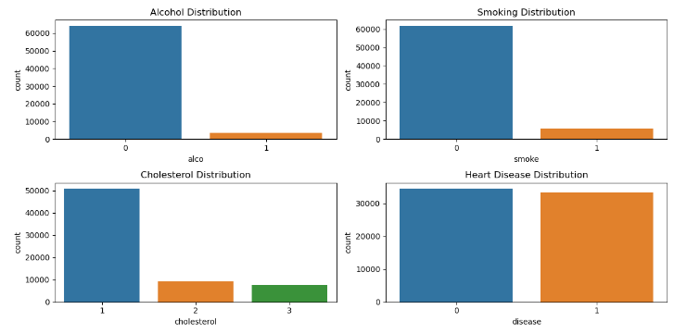
Visual analysis

Slide 22

3. Feature Selection & Training Model

Slide 23
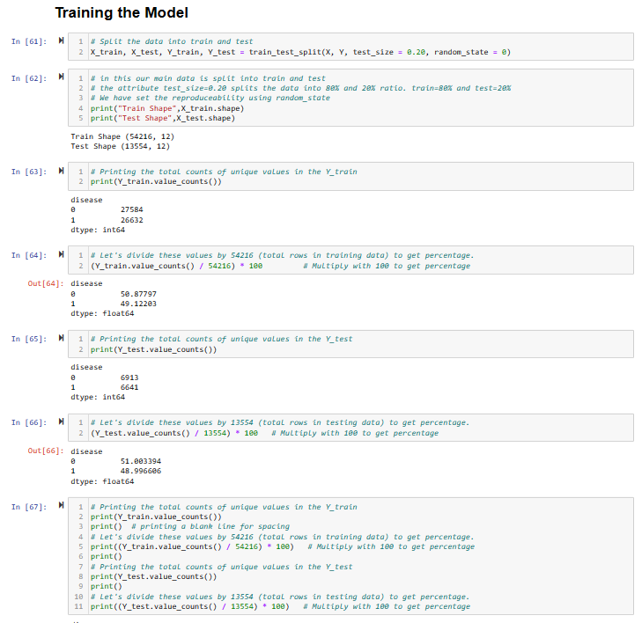
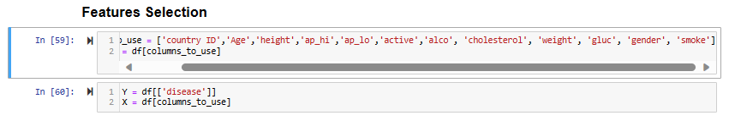
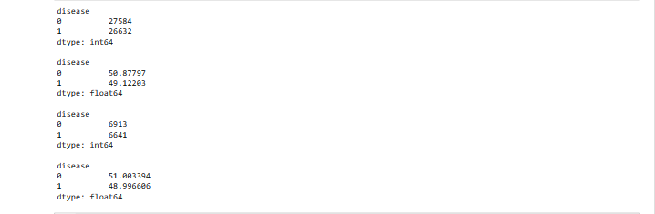
Splitting the data to train and test sets
Feature Selection

Slide 24

4&5. Choose and Evaluate Models
Logistic Regression Classification
k-Nearest Neighbour (k-NN) Classification
Random Forest Classifier

Slide 25
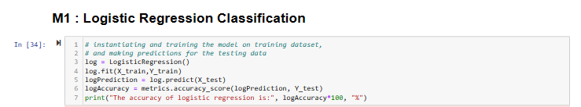
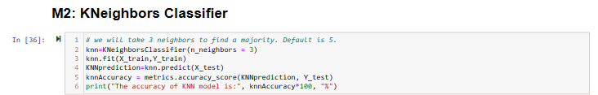
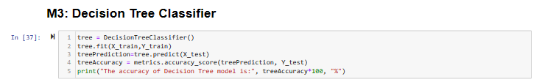
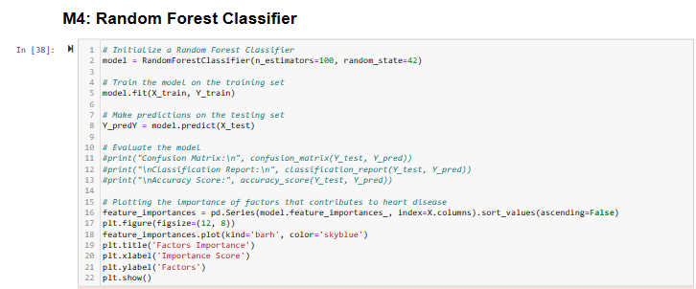
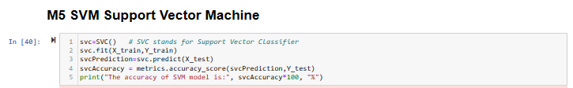
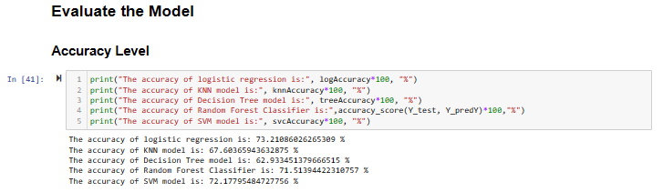

Slide 26
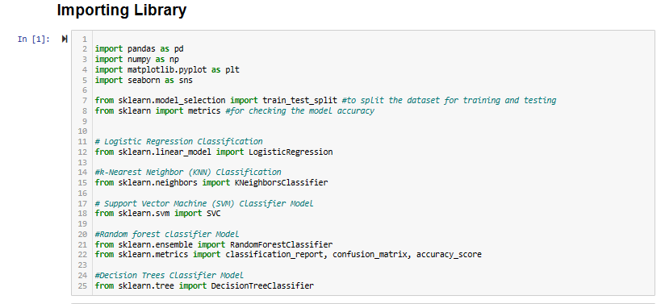
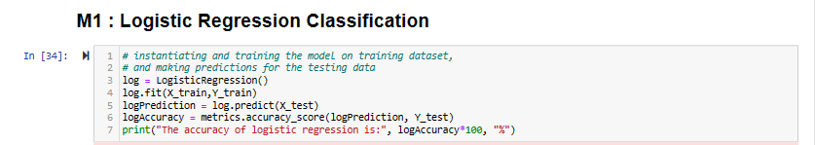
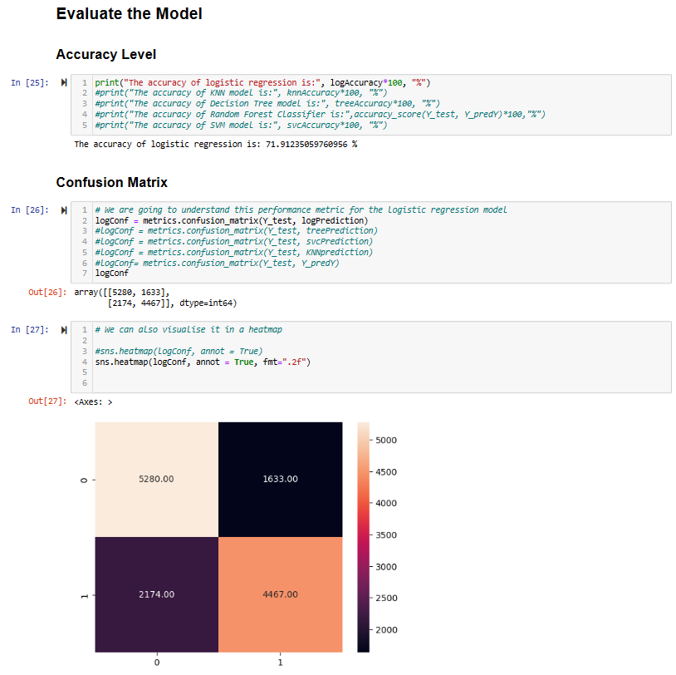
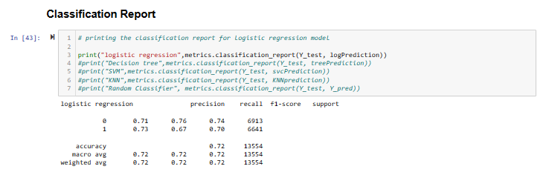
Logistic Regression Classification

Slide 27
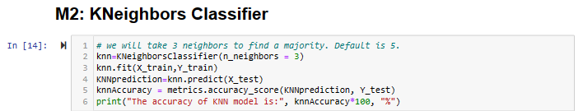
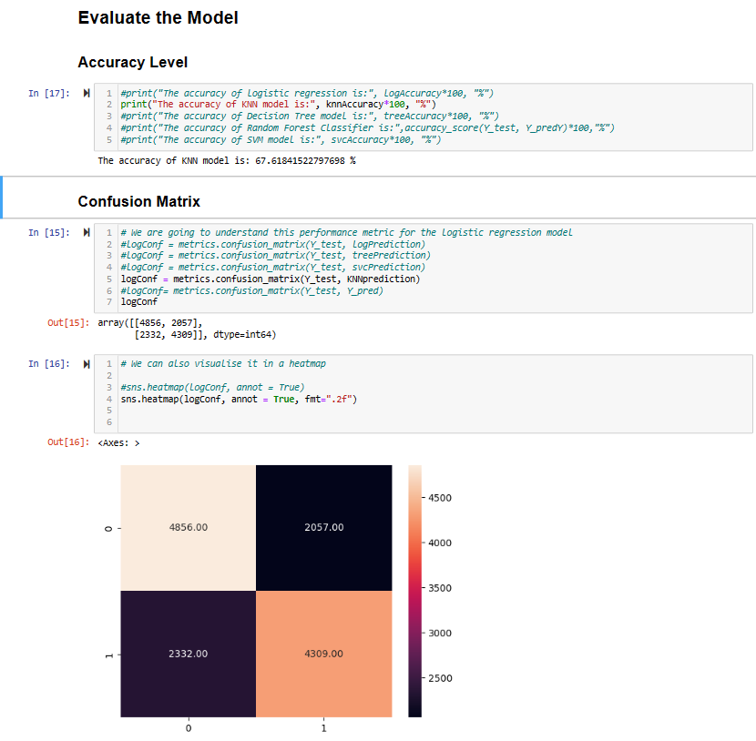
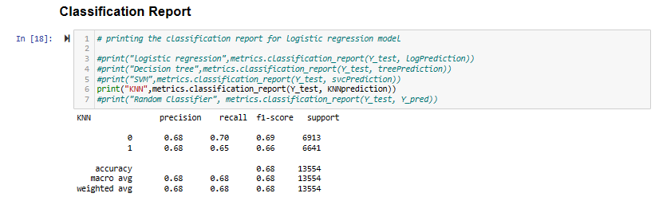
k-Nearest Neighbour Classification

Slide 28
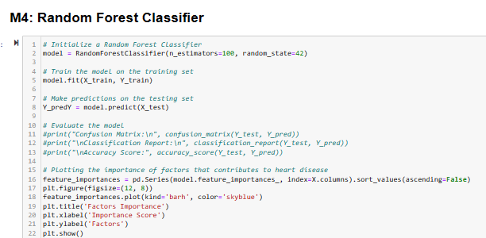

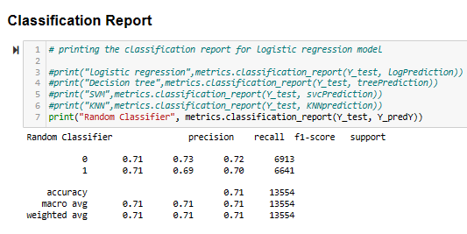
Random Forest Classifier

Slide 29
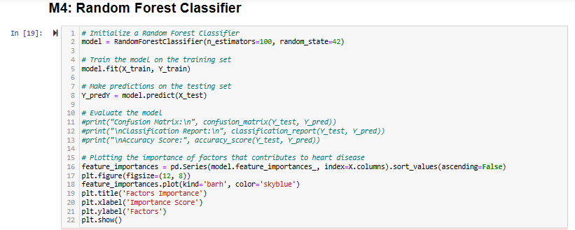
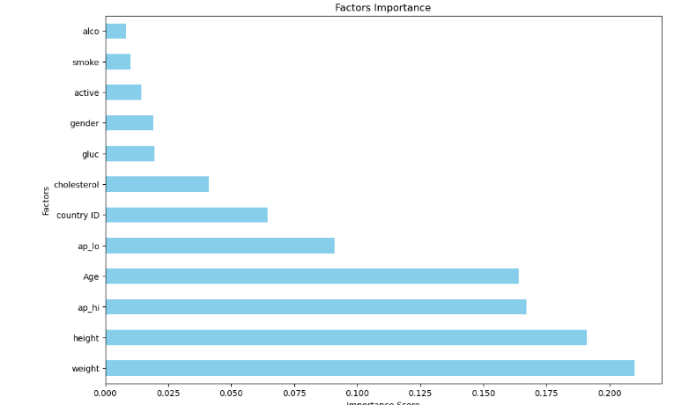
Random Forest Classifier

Slide 30

6. Test Model

Slide 31
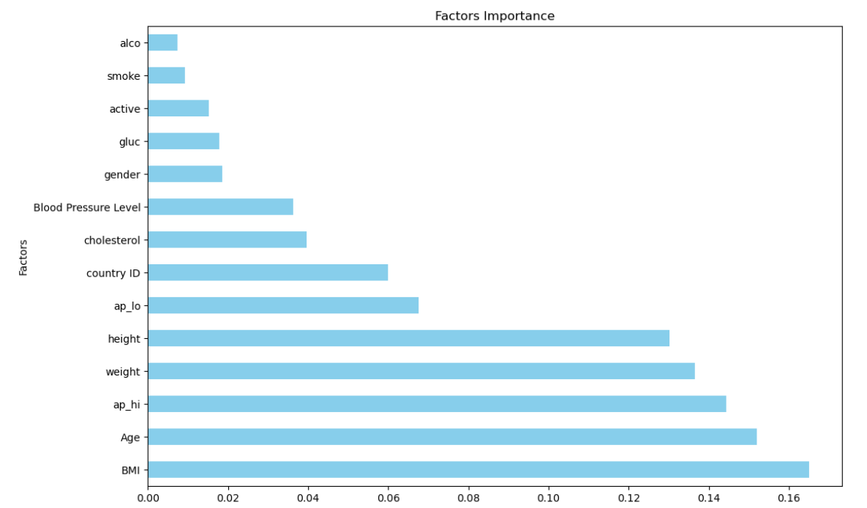
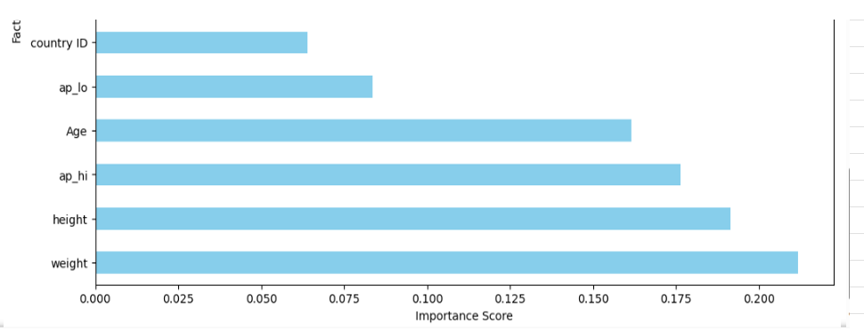
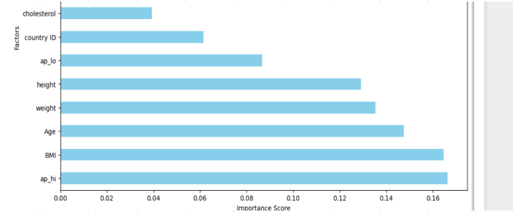
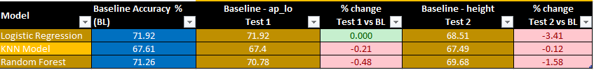
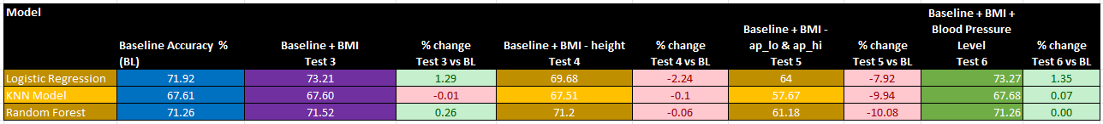
6. Test model
How is accuracy level changed by removing / adding new feature ? How does factor importance level affect model accuracy ?
Baseline remove one feature
Baseline add new feature BMI

Slide 32

D. RECOMENDATIONS

Slide 33
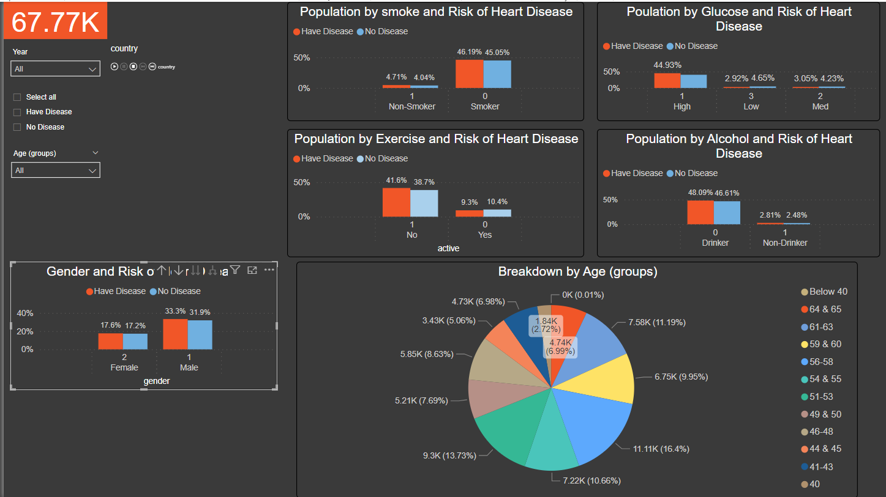

D. Recommendation
Data set quality
More patient data for age above 55 and below 40, smoker, drinker → Data collection team
How derive disease and non-disease is unknown → Data collection team
Any % weight for each factor → If any ?
The interpretation of each factor coding (0,1)
→ Assumption during cleaning is correct after rechecking Power BI → Master file for consistency and easy reference
Gender coding 0 and 1 interpretation → Data compilation team

Slide 34








D. Recommendation
Other factors to be considered

Slide 35
Appendix

Slide 36




Appendix
https://my-doc.com/ask-a-dietitian/easy-guide-to-understanding-food-labels-when-you-have-high-cholesterol/
High Blood Pressure | Singapore Heart Foundation (myheart.org.sg)
BMI Calculator | Singapore Heart Foundation (myheart.org.sg)
Blood Pressure (activ8rlives.com)

